Slide 1
Bharati Vidyapeeth
(Deemed to be University)
College of Engineering, Pune
Presentation on
“BUDGET TRACKING SYSTEM”
ROLL NO. | NAME | PRN | SEAT NO.
40 | HARDIKA TANDEL | 2214110274 | 2422930552
23 | AASHRAY MAHESHWARI | 2214110256 | 2422930538
19 | KSHITIJ KAMDI | 2214110243 | 2422930534
63 | NAVNEET GIRI | 2314110777 | 2422930568
HoD : Dr. Sandeep Vanjale

Slide 2
INTRODUCTION
The Budget Tracking Website project aims to develop an online platform that empowers individuals to manage their finances effectively by tracking their income, expenses, and savings goals. In an increasingly digital world, where financial literacy is crucial, this website provides a user-friendly solution for users to gain insights into their spending habits, set budgets, and work towards achieving financial stability.

Slide 3
Integration with IT Management
Let us see various aspects of IT Management related to the budget tracking system:
IT Strategy and Planning
IT Governance and Compliance
IT Project Management
IT Service Management (ITSM)
IT Security Management
IT Financial Management

Slide 4
IT Strategy and Planning:
The budget tracking system supports the alignment of IT spending with strategic objectives by providing visibility into budget allocations and expenditures against strategic goals.
It facilitates budget planning processes by enabling IT managers to forecast future expenses, allocate resources strategically, and prioritize investments based on business priorities.
2. IT Governance and Compliance
The budget tracking system helps ensure compliance with financial regulations and governance frameworks governing IT expenditures by enforcing budget controls, maintaining audit trails, and providing transparency into financial transactions.
It facilitates compliance reporting by generating financial reports, documenting budget approvals, and tracking expenditure compliance with regulatory requirements.
3. IT Project Management
The budget tracking system assists in managing IT project budgets by tracking project expenses, monitoring spending against budget allocations, and identifying variances that may impact project delivery.
It helps in forecasting project costs accurately by providing insights into resource utilization, identifying cost-saving opportunities, and adjusting budgets based on project requirements.

Slide 5
4. IT Service Management (ITSM)
The budget tracking system contributes to cost-effective delivery of IT services by tracking service-related expenses, optimizing resource allocation, and identifying opportunities for service improvement.
It enhances financial transparency in IT service delivery by providing insights into service costs, enabling cost allocation to specific services or departments, and facilitating chargeback or showback mechanisms.
5. IT Security Management
The budget tracking system supports budgeting for cybersecurity measures by tracking security-related expenses, allocating resources for security initiatives, and ensuring alignment with security objectives.
It assists in managing security investments by prioritizing security spending, identifying cost-effective security solutions, and assessing the ROI of security investments.
6.IT Financial Manangemnt
The budget tracking system aids in managing IT budgets by tracking IT expenditures, monitoring budget performance, and providing insights for financial decision-making.
It optimizes resource allocation by identifying cost-saving opportunities, reallocating funds to high-priority initiatives, and ensuring efficient use of financial resources.

Slide 6
FEATURES
Expense tracking and categorization
Budget planning and management
Goal setting and tracking
Reporting and analytics
Integration with financial systems and IT management tools

Slide 7
Benefits of Using the Budget Tracking System
Improved visibility and control over IT expenditures
Enhanced decision-making through data-driven insights
Better alignment of IT spending with business objectives
Increased transparency and accountability in financial management
Optimization of resource allocation and cost savings opportunities

Slide 8
CASE STUDIES
Case Study | Background | Solution | Results
Company X | Medium-sized manufacturing company with multiple departments | Implemented a cloud-based budget tracking system to streamline financial management processes | Improved visibility into financial data Cost savings through identifying areas of overspending Strategic alignment of spending with goals
Organization Y | Non-profit organization providing educational services | Implemented a tailored budget tracking system to track expenses across programs and projects | Enhanced transparency into financial data Grant compliance and accountability - Improved financial management processes
Startup Z | Technology startup developing a mobile application for finance | Integrated a budget tracking system with accounting software to manage startup expenses effectively | Financial control and real-time expense tracking Investor confidence through accurate financial reporting

Slide 9
SUGGESTED CHANGES
Add expense category
Displaying budget limit for each category expense
Realtime budget updation
Whenever the expense exceeds the budget limit , the category becomes inactive.
Login system
Monthly report generation

Slide 10
USER INTERFACE

Slide 11
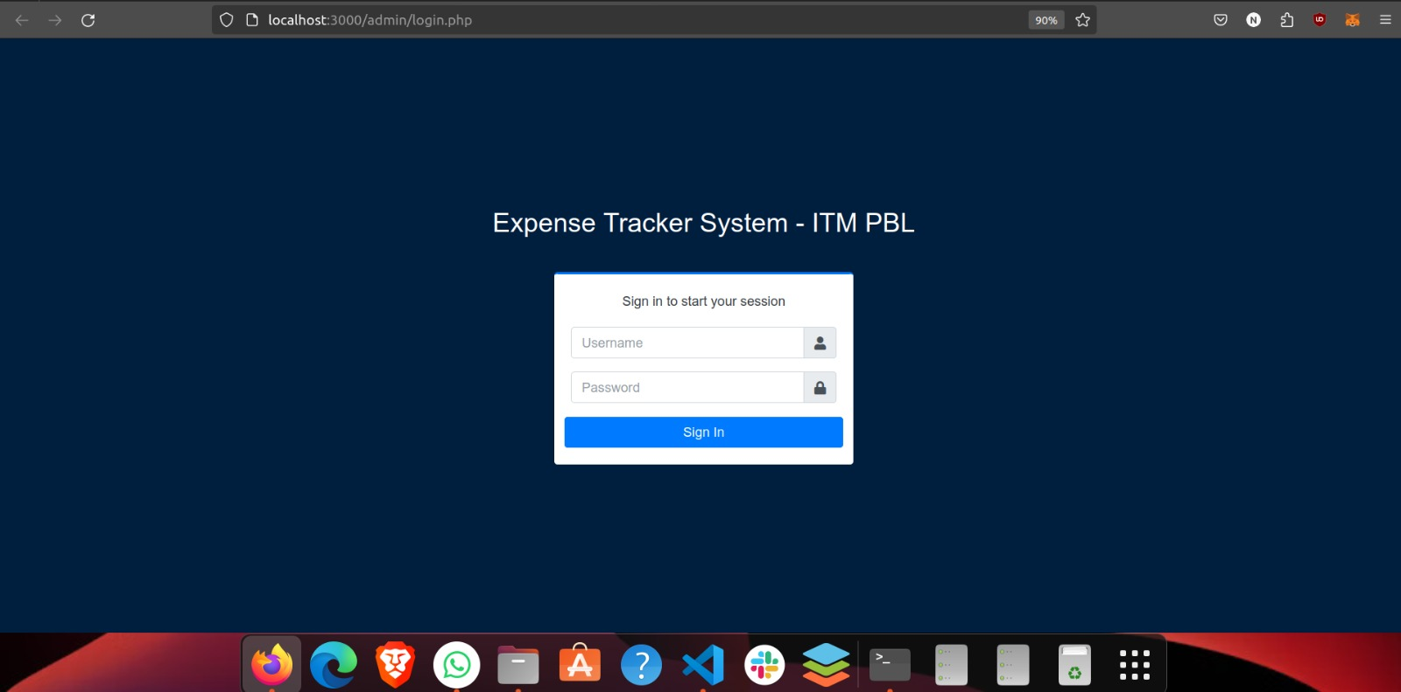
Login Page

Slide 12
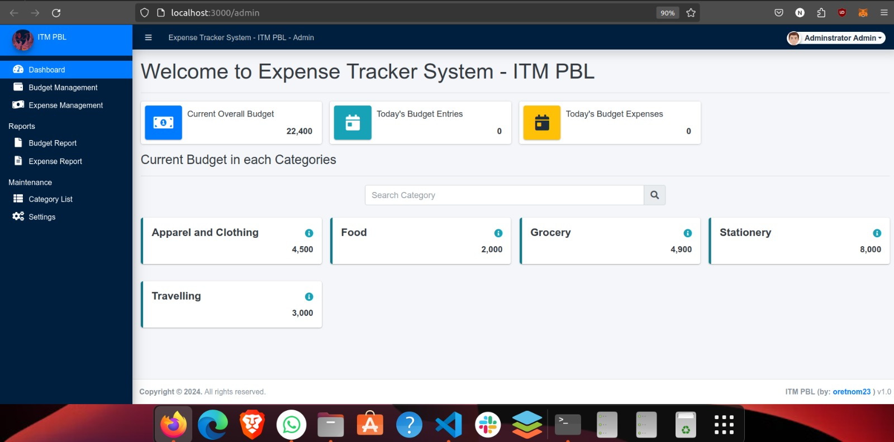
Dashboard

Slide 13
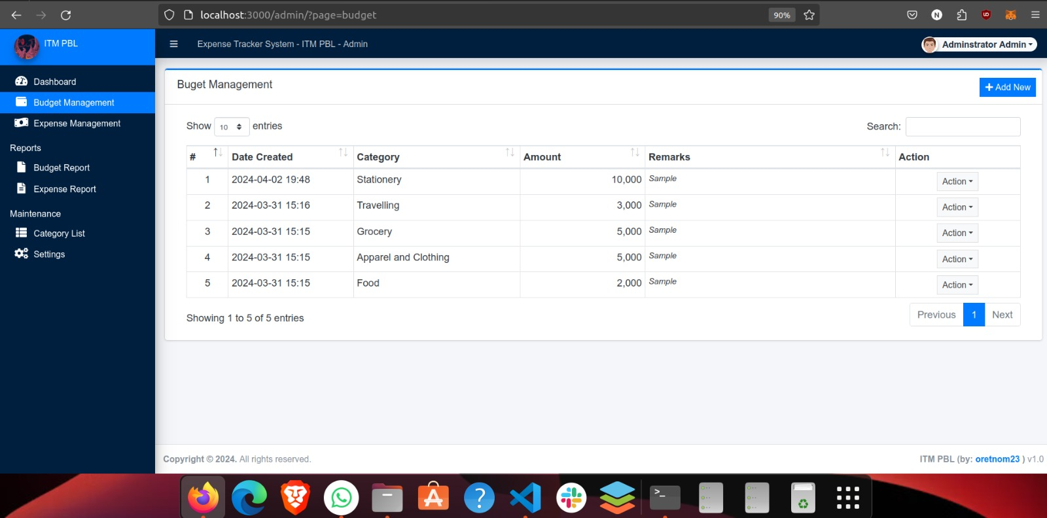
Budget setting Page

Slide 14
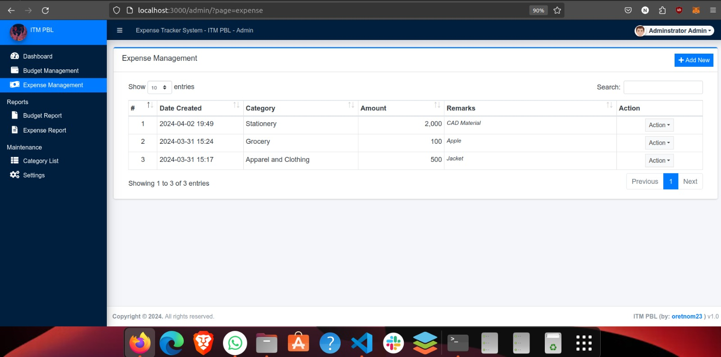
Expense Tracking

Slide 15
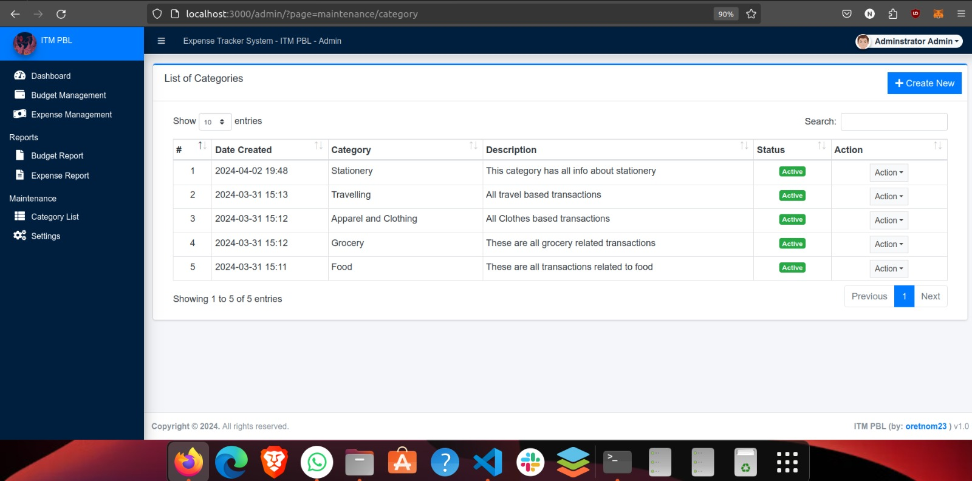
Adding Categories in expense section

Slide 16
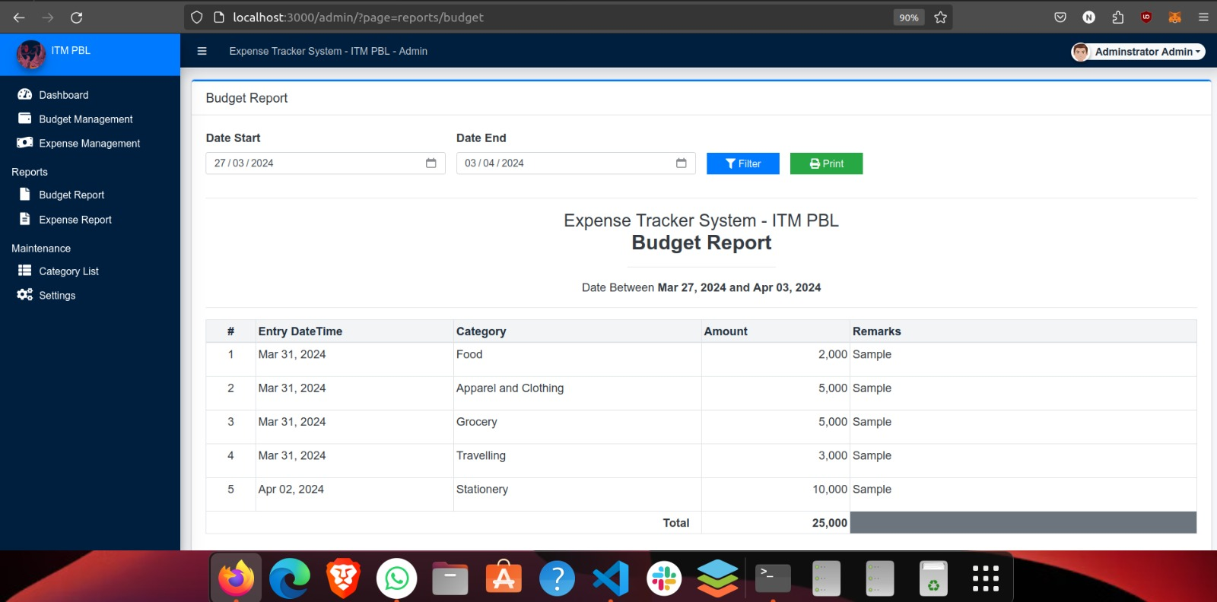
Report of Monthly Expense

Slide 17
CONCLUSION
In conclusion, the budget tracking system plays a crucial role in the realm of IT service management by providing a comprehensive platform for managing financial resources effectively. Through its functionalities, the budget tracking system intertwines with various aspects of IT service management, contributing to the efficiency, transparency, and accountability of IT operations. It enables IT managers to set budgets, track expenses, and monitor spending patterns across different IT projects and departments. By providing insights into budget performance and variance analysis, the system facilitates informed decision-making regarding resource allocation and optimization.

Slide 18
THANK YOU

